Slide 1
Statistics: Basic Concepts

Slide 2
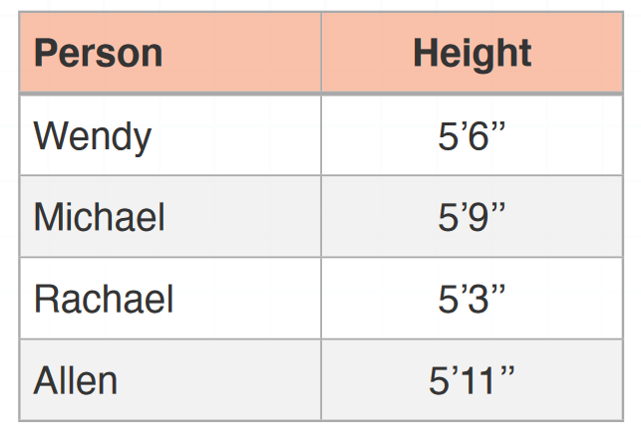
Individuals and Variables
Individuals: Items in a data set and can be cases, things, people, etc
They have one or more properties, called as variables
Height is a variable because height is a property of each individual
Individuals are the people

Slide 3
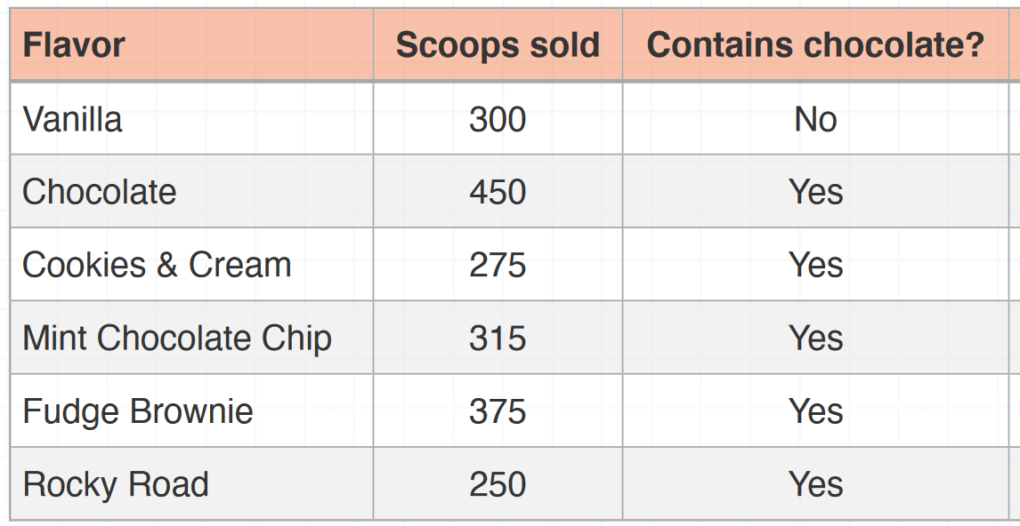
Data and Data Table
Data = Individuals + Variables
Data table: Data organized in a tabular form

Slide 4
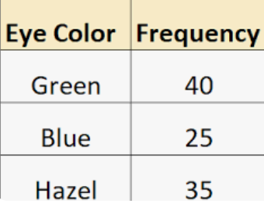
Variable Types
Two types: Categorical and Quantitative
Categorical variables: Non-numeric, Qualitative
Quantitative variables: Numeric, Can be measured precisely
Categorical
Quantitative

Slide 5
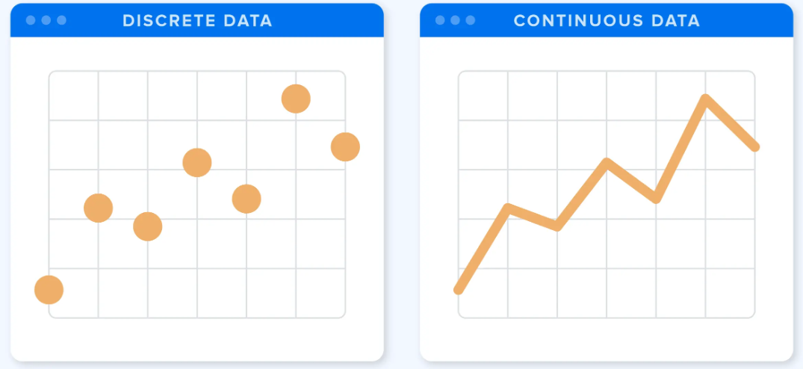
Quantitative Variable Sub-types
Discrete variables: We can count these, e.g. the number of books sold (we cannot sell 8.3 or 7.25 books)
Continuous variables: May include decimals, fractions, or irrational numbers, e.g. height of people

Slide 6
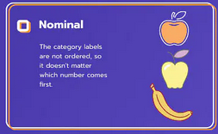
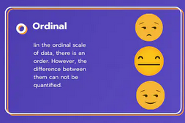
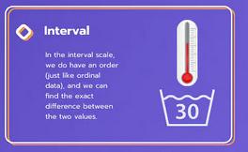
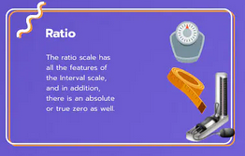
Four Levels of Measurement
Nominal
Ordinal
Interval
Ratio

Slide 7
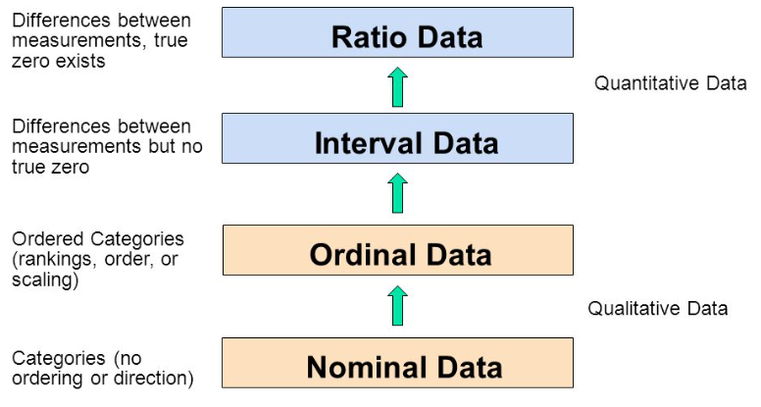
Types of Data

Slide 8
Nominal Data
Nominal data: Data that can be classified into categories or groups, but they do not have any inherent order or ranking
Simplest, Used for qualitative data
Examples: Gender (Male/Female), Marital Status (Single/Married/Divorced), Eye Color (Brown/Blue/Green), Ethnicity (Caucasian/African-American/Asian/Latino)
Possible Statistical measures: Contingency tables, Chi-square tests, Frequency distributions, Percentages, Ratios
Not possible: Mean or median, since there is no inherent order to the data

Slide 9
Ordinal Data
Ordinal data: Data that can be ranked or ordered based on values
Note: The difference between the values is not necessarily the same
Examples: Educational qualification (e.g., high school, associate degree, bachelor's degree, master's degree), Ratings (e.g., poor, fair, good, very good, excellent)
Can be treated as numerical data for analysis sometimes
Example: Customer satisfaction level: Very unhappy = 0 … Extremely happy = 5 ---> Now find correlation between age and satisfaction level
Possible statistical measures: Mean, Median, Percentile, Chi-square test, Correlation

Slide 10
Interval Data
Interval data: Data that have a numerical value or measurement and can be ranked or ordered
No true zero (See next slide)
Example: Temperature measured in degrees Celsius or Fahrenheit
0°C: Freezing point of water, 0°F: Based on historical conventions, Neither of these zero points represents the absence of temperature (absolute zero) ….. But 0 marks are 0 marks
So, we cannot say that 40°C is twice as hot as 20°C
Possible statistical measures: Mean, Median, Variance, Standard deviation, Correlation

Slide 11
True Zero Concept
Interval data has an arbitrary zero starting point
Ratio data has a true zero starting point
0°C temperature: It is not the lowest, since it translates to 32°F; and we can have temperatures lower than that as well, e.g. -1°C … Arbitrary zero starting point -> Interval data … 0 does not really mean 0
Marks obtained by students in an exam: 70, 0, 30, 56, 82: Here, we may have a student who really got zero marks and there cannot be any negative marks … True zero starting point -> Ratio data … 0 means 0

Slide 12
Ratio Data
Ratio data: Quantitative data that starts with a natural zero point (i.e. true zero) and can be measured on a continuous scale with equal intervals between values
Ratios are meaningful here: Example: 80 marks are actually twice better than 40
As noted earlier, in interval data, twice high temperature may not have meant twice the heat
Examples: Weight, height, distance
Possible statistical measures: Mean, Median, Standard deviation, Correlation, Regression, ANOVA, t-tests

Slide 13
Descriptive Statistical Measures

Slide 14
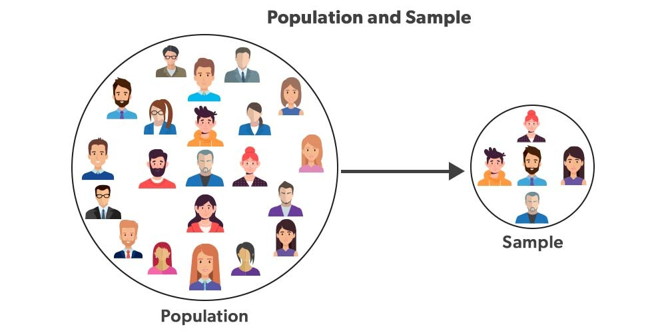
Population versus Sample

Slide 15
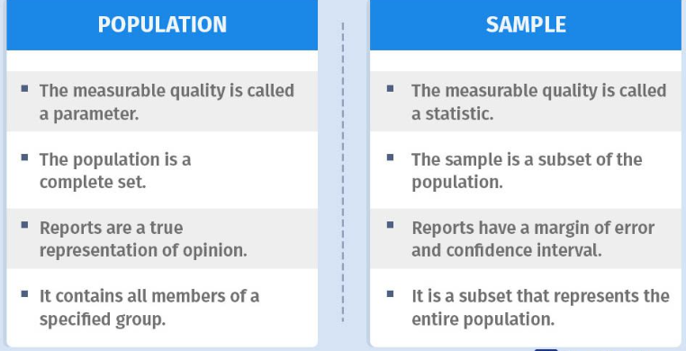
Population versus Sample

Slide 16
Measures of Location
Measures of Location: A single value that represents the “centering” of a set of data, e.g. average
Also called Measures of Central Tendency
Example: Marks obtained by 10 students, arranged in an ascending order … 45,56,61,65,68,71,73,79,82,88,91
Possible measure of location:
45,56,61,65,68, 71, 73,79,82,88,91
Measures of Location
Mean
Mode
Median

Slide 17
Basic Usage
Mean: Better if the data is normally distributed and there are no outliers
Median: Better when the data is skewed (has extreme values)
Mode: Useful for identifying the most common value or values in a dataset

Slide 18
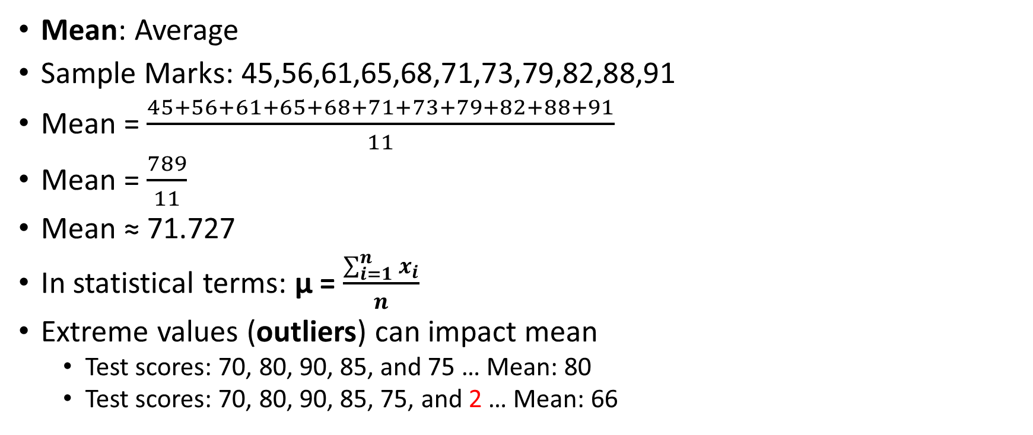
Mean
Mean: Average
Sample Marks: 45,56,61,65,68,71,73,79,82,88,91
Mean = $\frac{45+56+61+65+68+71+73+79+82+88+91}{11}$
Mean = $\frac{789}{11}$
Mean ≈ 71.727
In statistical terms: μ = $\frac{\sum_{i=1}^{n}{x_{i}}}{n}$
Extreme values (outliers) can impact mean
Test scores: 70, 80, 90, 85, and 75 … Mean: 80
Test scores: 70, 80, 90, 85, 75, and 2 … Mean: 66

Slide 19
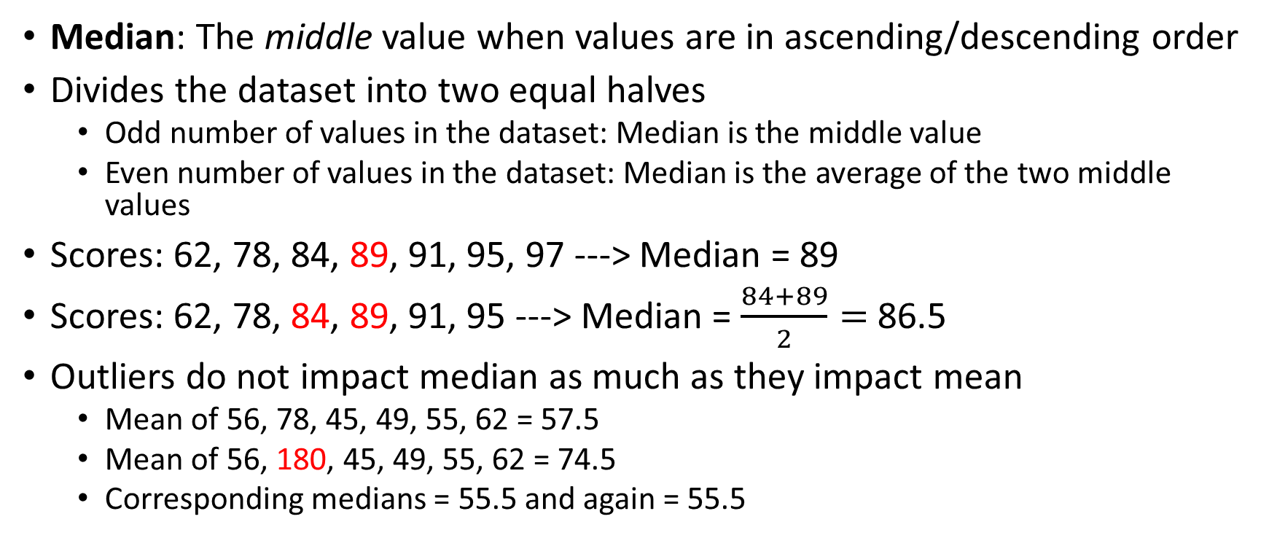
Median
Median: The middle value when values are in ascending/descending order
Divides the dataset into two equal halves
Odd number of values in the dataset: Median is the middle value
Even number of values in the dataset: Median is the average of the two middle values
Scores: 62, 78, 84, 89, 91, 95, 97 ---> Median = 89
Scores: 62, 78, 84, 89, 91, 95 ---> Median = $\frac{84+89}{2}=$86.5
Outliers do not impact median as much as they impact mean
Mean of 56, 78, 45, 49, 55, 62 = 57.5
Mean of 56, 180, 45, 49, 55, 62 = 74.5
Corresponding medians = 55.5 and again = 55.5

Slide 20
Mode
Mode: The value that occurs most frequently in a dataset
Data: 62, 78, 84, 89, 91, 95, 97, 89, 91, 89
Frequency: 62: 1, 78: 1, 84: 1, 89: 3, 91: 2, 95: 1, 97: 1
Mode = 89
What if there are multiple values with the same highest frequency?: Multimodal data
If we have two modes: bi-modal
If we have three modes: tri-modal
Not used much in practice

Slide 21
Measures of Dispersion
Spread: How and by how much, our data set is spread out around its center?
Called Measures of Dispersion or Scatter
Measures of Dispersion
Range
Variance
Standard Deviation

Slide 22
Range
Range: Difference between the maximum value and the minimum value in the data set
Affected by outliers
Example: 8, 11, 5, 9, 7, 6, 2500
Range = Max – Min = 2500 – 5 = 2495, which is quite meaningless
Solution: Inter Quartile Range (IQR)
But first, we need to understand percentile and quartile
Range
Minimum
Maximum

Slide 23
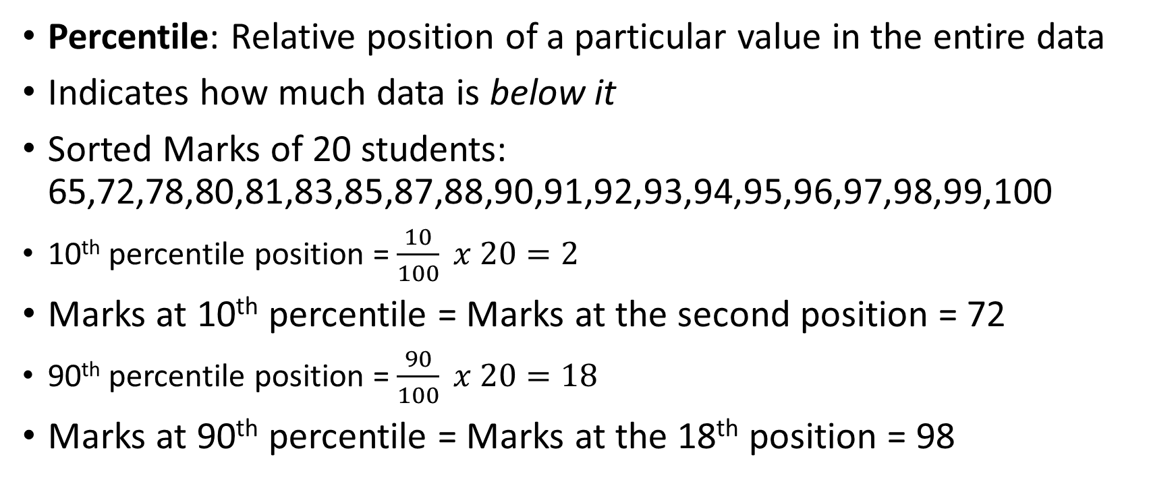
Percentile
Percentile: Relative position of a particular value in the entire data
Indicates how much data is below it
Sorted Marks of 20 students: 65,72,78,80,81,83,85,87,88,90,91,92,93,94,95,96,97,98,99,100
10th percentile position = $\frac{10}{100} x 20=2$
Marks at 10th percentile = Marks at the second position = 72
90th percentile position = $\frac{90}{100} x 20=18$
Marks at 90th percentile = Marks at the 18th position = 98

Slide 24
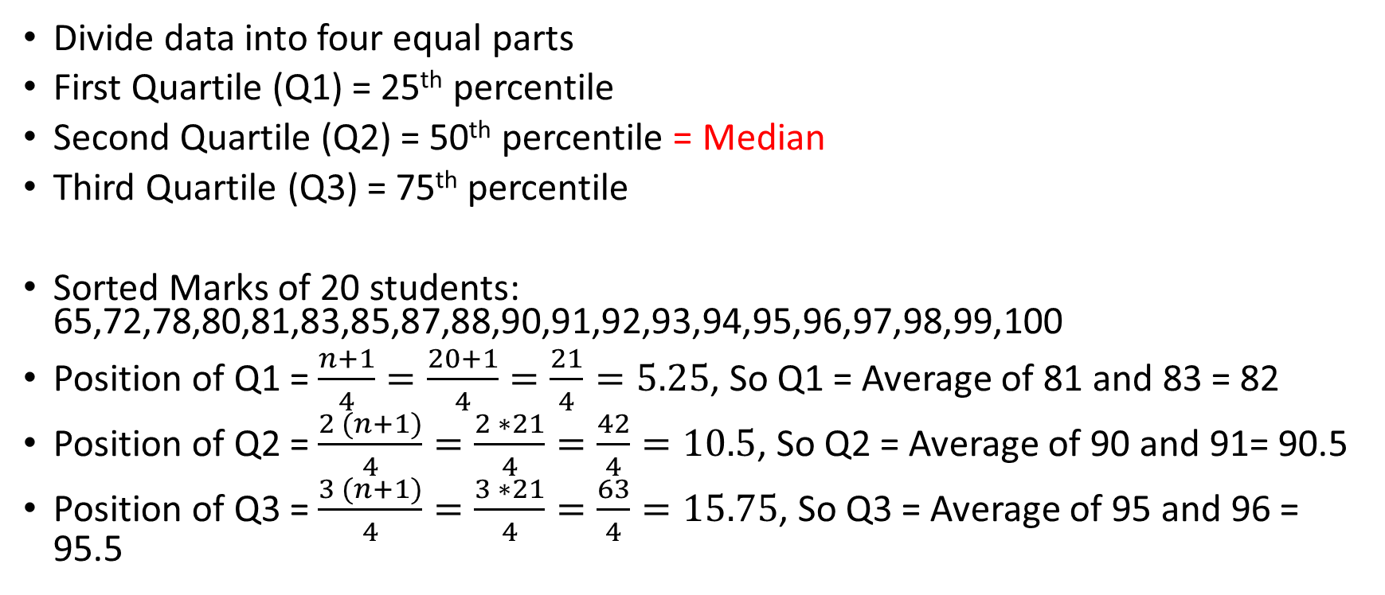
Quartile
Divide data into four equal parts
First Quartile (Q1) = 25th percentile
Second Quartile (Q2) = 50th percentile = Median
Third Quartile (Q3) = 75th percentile
Sorted Marks of 20 students: 65,72,78,80,81,83,85,87,88,90,91,92,93,94,95,96,97,98,99,100
Position of Q1 = $\frac{n+1}{4}=\frac{20+1}{4}=\frac{21}{4}=5.25$, So Q1 = Average of 81 and 83 = 82
Position of Q2 = $\frac{2 (n+1)}{4}=\frac{2 ∗21}{4}=\frac{42}{4}=10.5$, So Q2 = Average of 90 and 91= 90.5
Position of Q3 = $\frac{3 (n+1)}{4}=\frac{3 ∗21}{4}=\frac{63}{4}=15.75$, So Q3 = Average of 95 and 96 = 95.5

Slide 25
Inter Quartile Range (IQR)
Inter Quartile Range (IQR) = Q3 – Q1
In the given example,
IQR = Q3 – Q1 = 95.5 – 82 = 13.5
IQR handles outliers better than range, since the extreme values at both the ends are ignored in IQR
Also, it focuses on the middle part of the data
Since it uses percentiles rather than actual values, it is less affected by skewed data

